Slide 1

Motors and Servos
The Antidote - FTC 14320

Slide 2
Motors
In the FIRST Tech Challenge, teams are only allowed to use up to eight motors
Four on each REV Expansion Hub or Control Hub
Every motor has a set max torque and max speed.
Gearbox ratios help manipulate the max torque and max speed to best suit certain applications
A general rule of thumb is be under half of the motor’s stall torque (can usually be found in motor specifications)

Slide 3
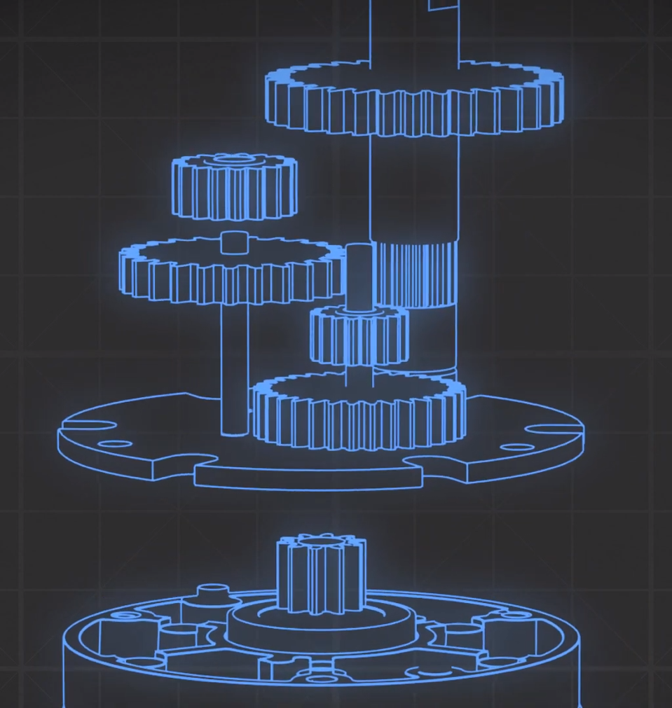
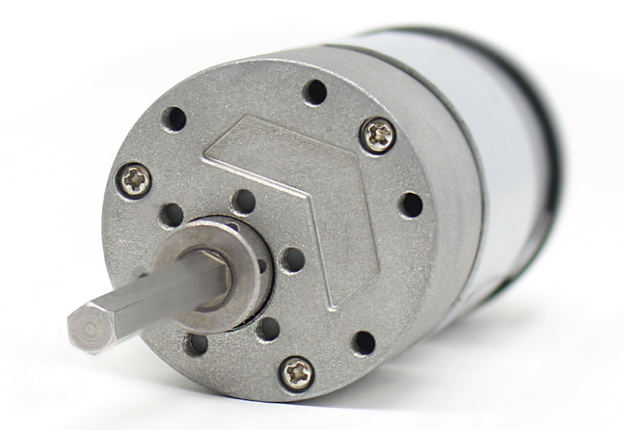
Types of Motors
Spur Gear Motors
Consists of numerous reduction (↑ torque, ↓ speed) geared stages
Output shaft is typically not centered with the gearbox
Helps with belt/chain tension
Less durable than other gearbox options

Slide 4
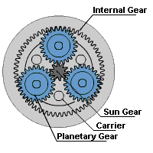
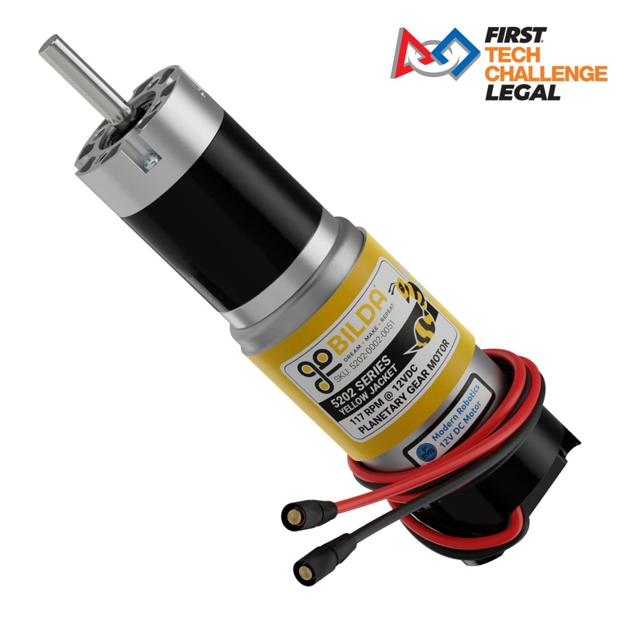
Types of Motors
Planetary Gear Motors
Consists of numerous sun + planet reduction stages → extremely reliable/efficient
Centered shaft and compact → better radial/axial load

Slide 5
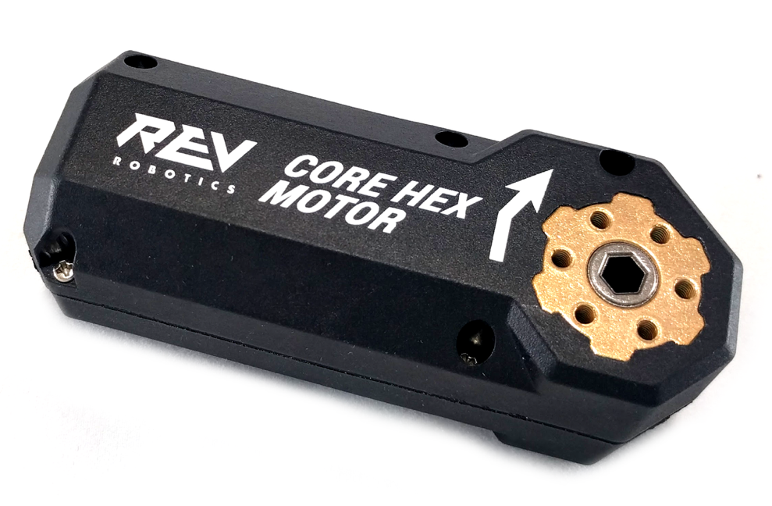
Types of Motors
Through Bore Motors
Instead of having an output shaft, through bore motors have a slot so that a shaft can be inserted
REV Core Hex Motor
Spur Styled Gearbox
Any shaft length can be used
Very loud & inefficient power output
Unusual gear ratio
72:1 is not commonly used
Uses a less powerful motor than other FTC motors

Slide 6
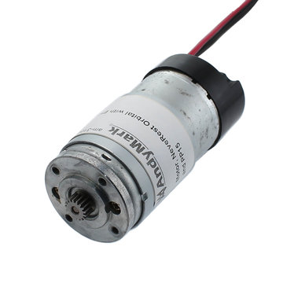
Types of Motors
Bare Motor
These motors (sold by AndyMark and REV Robotics) do not have an external gearbox, only a pinion gear
Teams use bare motors for custom gearboxes, primarily for lift mechanisms or intakes

Slide 7
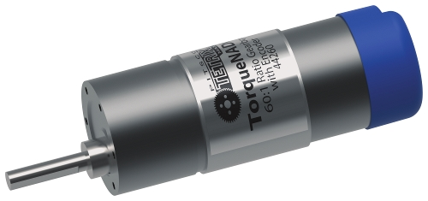
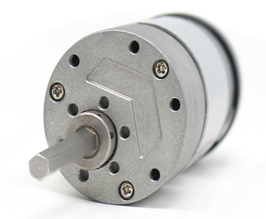
Motor Comparison Chart
Type | REV HD Hex | AM Classic | Tetrix TorqueNADO
Gearbox | Spur | Spur | Spur
Ratio | 20:1 / 40:1 | 40:1 / 60:1 | 20:1 / 40:1 / 60:1
Cost | $28 | $29.50 | $30

Slide 8
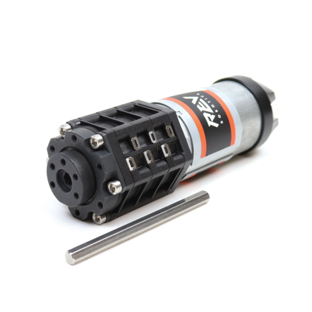
Motor Comparison Chart
Type | AndyMark Orbital | REV UltraPlanetary | REV HD Hex | goBILDA Yellow Jacket
Gearbox | Planetary | Planetary | Planetary | Planetary
Ratio | 3.7:1 / 19.2:1 | 3:1, 4:1, 5:1 Cartridges | 19.2:1 | 3.7:1 to 188:1
Cost | $33 | $36 | $32 | $30 (with discount)

Slide 9
Selecting a Motor
Avoid using spur gear motors (not recommended)
Spur gears are made of numerous layers of gears to create the final ratio
Spur gears wear down rapidly → leads to a free moving shaft
Can not withstand the rigors of the FTC competition
Use planetaries! (recommended)
Planetaries are the most reliable motors to use in FTC
Load is distributed equally among the gears
Very rare for a planetary motor to break down
goBILDA offers a wide range of ratios to be used in any FTC application.

Slide 10
Motor Mounts
Clamping Mounts
Clamps onto the circular body of the motor
Tapped holes allow the motor to be placed on any flat surface
Different motor brands have different motor diameters

Slide 11
Motor Mounts
Face Mounting
Uses the screw holes on the face of the motor to mount the motor
Can either use a physical bracket to help with the mounting process
Recommended option for FTC applications compared to clamping mounts

Slide 12
Servos
In the FIRST Tech Challenge, teams are only allowed to use up to twelve servos
Six on each REV Expansion Hub or Control Hub
Every motor has a set max torque and max speed.
Gearbox ratios help manipulate the max torque and max speed to best suit certain applications
A general rule of thumb is be under half of the motor’s stall torque (can usually be found in motor specifications)

Slide 13

Types of Servos
Positional (standard) Servos
Servos are primarily used for precise and repeatable moves
Can only rotate around 180 to 270 degrees
The input signal manipulates the position of the servo spline
Continuous Rotation Servos
These servos are similar to motors
The input signal manipulates the speed and direction of rotation
Continuous Rotation servos typically do not have any form of positional feedback

Slide 14
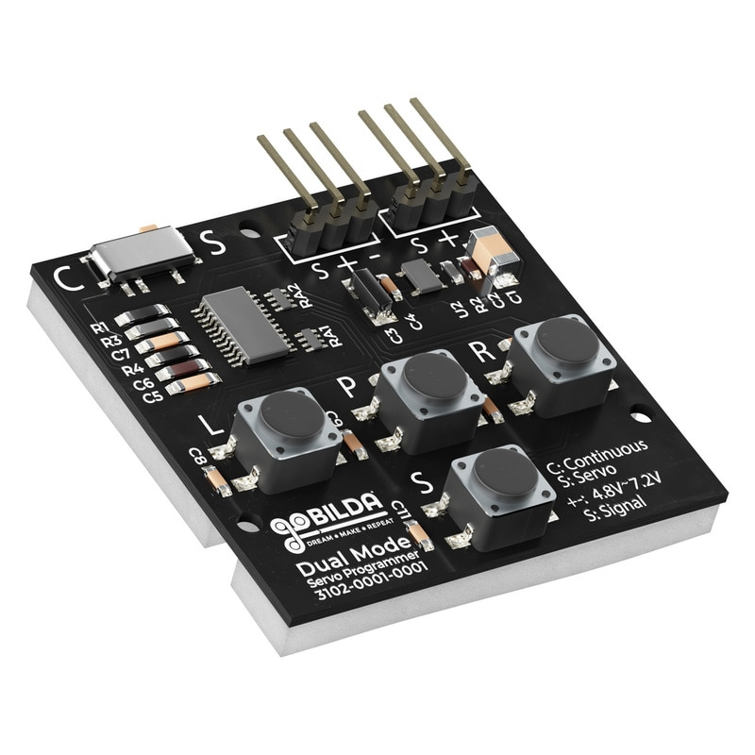
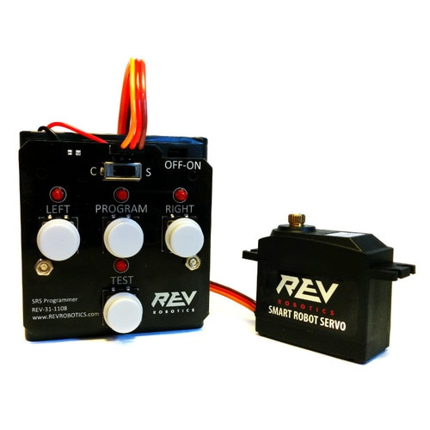
Programming Servos
A Servo Programmer (like the ones in the images) can set custom end-stops for positional servos and change the mode of certain servos from Continuous Rotation to Positional and vice versa.
The programmer can change the mode of REV’s Smart Robot Servo and goBILDA’s Dual Mode Servo.

Slide 15
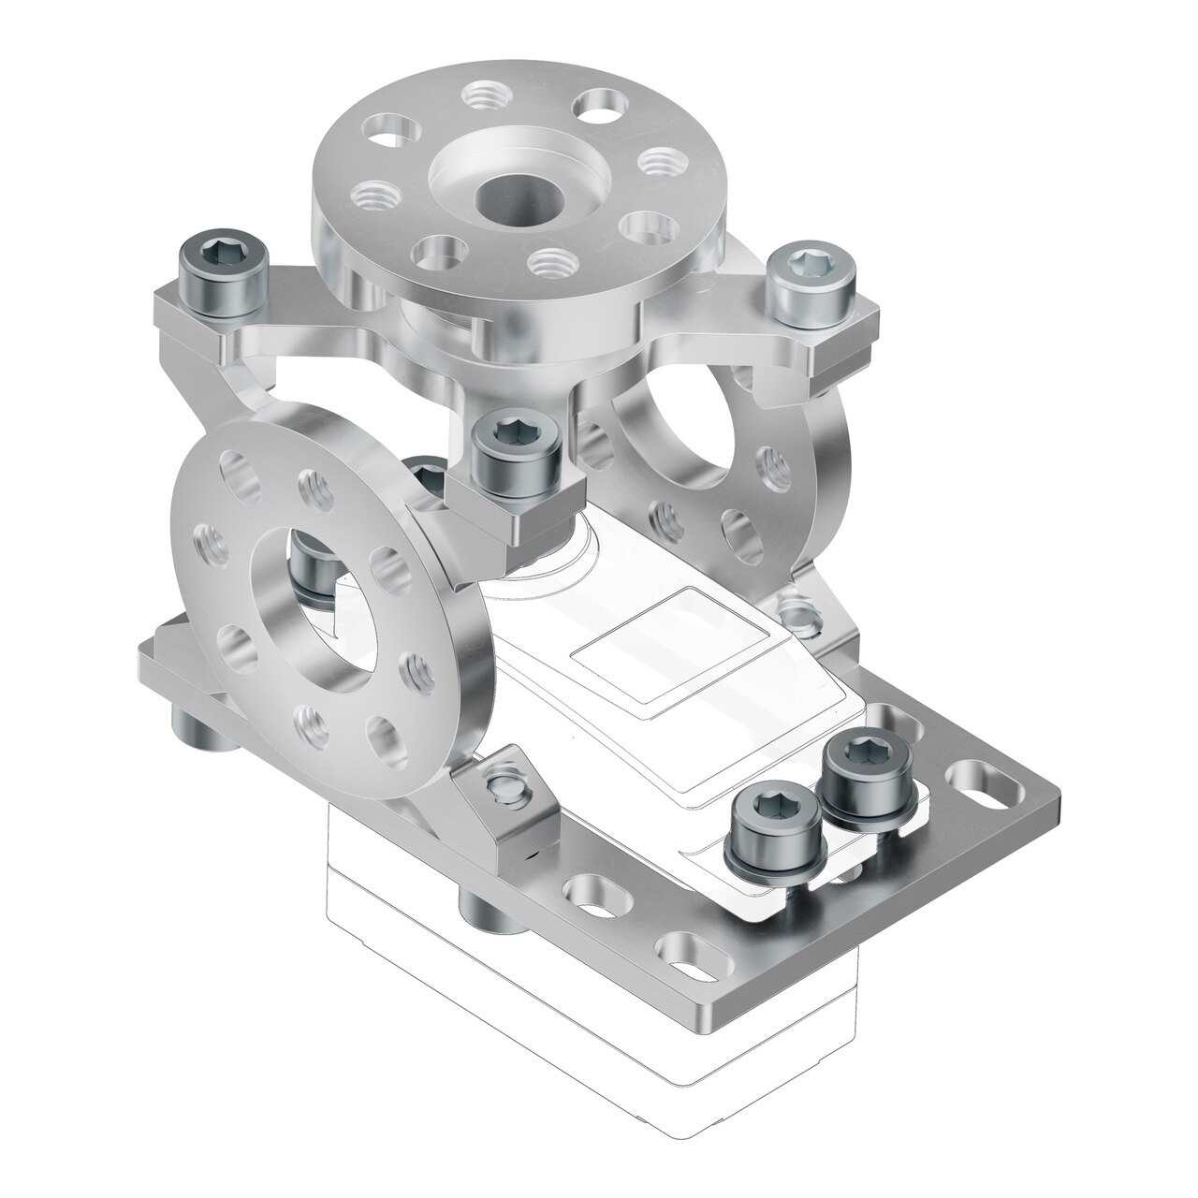
Servo Blocks
Sold by ServoCity and goBILDA
A limiting factor of servos is the amount of radial load that the servo can handle.
ServoBlocks acts as an exoskeleton and isolates the load onto the bearing located above the servo spline.
It is recommended that teams use ServoBlocks for any intensive or high-torque application

Slide 16
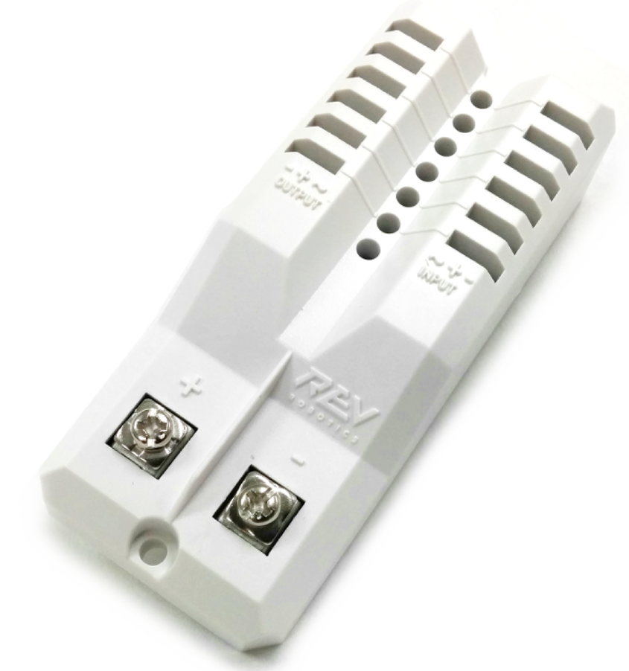
Servo Power Module (SPM)
Sold by REV
When a robot has many servos pulling current, the Servo Power Module ensures that servos will receive 6 Volts and 90 Watts of power.
This ensures that the servos connected to the SPM will run with consistent and maximum power.

Slide 17

Credits
This lesson was written by The Antidote 14320 for FTCTutorials.com
You can contact the author at:
Website:
http://theantidoterobotics.com
Twitter:
@theantidoteFTC
Email:
theantidoteftc@gmail.com
More lessons for FIRST Tech Challenge are available at www.FTCtutorials.com
Wording and Photo Credit: goBILDA, REV, AndyMark
This work is licensed under a
Creative Commons Attribution-NonCommercial-ShareAlike 4.0 International License.

